Slide 1
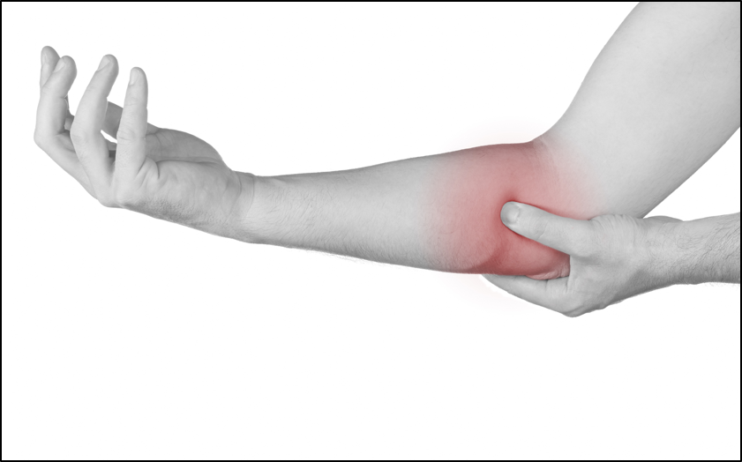
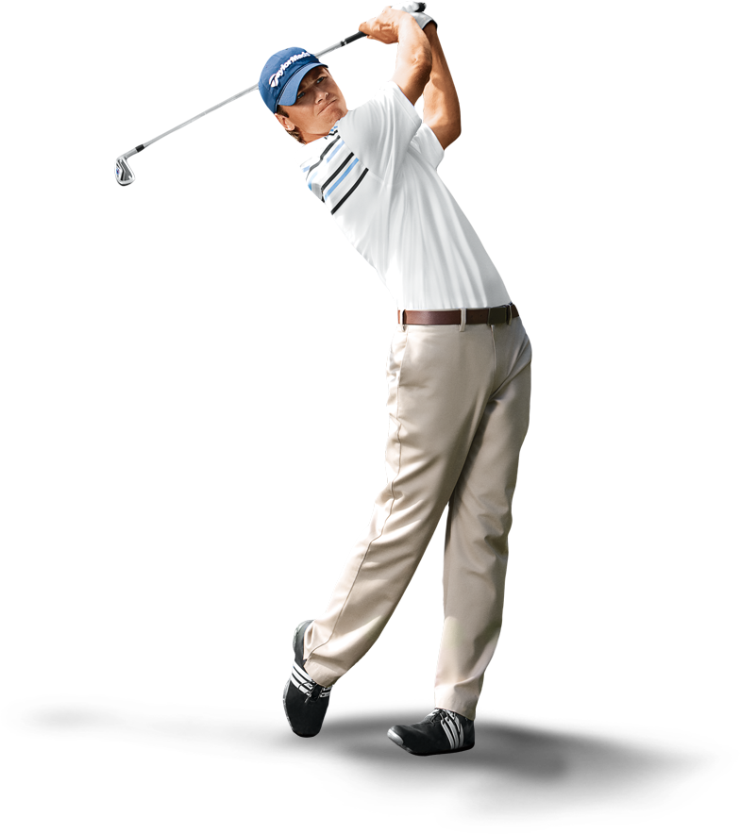
G
LFER’S ELBOW
PREVENTION
Swing Smart!
TEE TIME TACTICS
1.WARM UP
2.STRENGTHENING
3.SWING TECHNIQUE
Warming up before a round of golf can reduce injuries by 50% as well as improving grip strength.
Stronger muscles are less prone to injuries, assist precise ball striking and overall shot accuracy.
Practice your swing with a professional to ensure proper swing technique and avoid strain on your elbow.
SWING SMOOTH, STAY STRONG!
Scan here for more information.

Slide 2
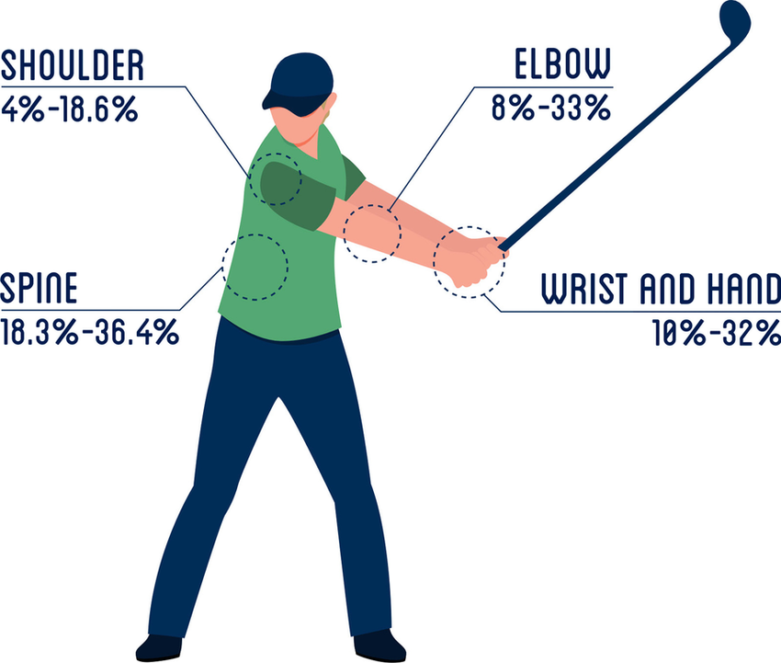
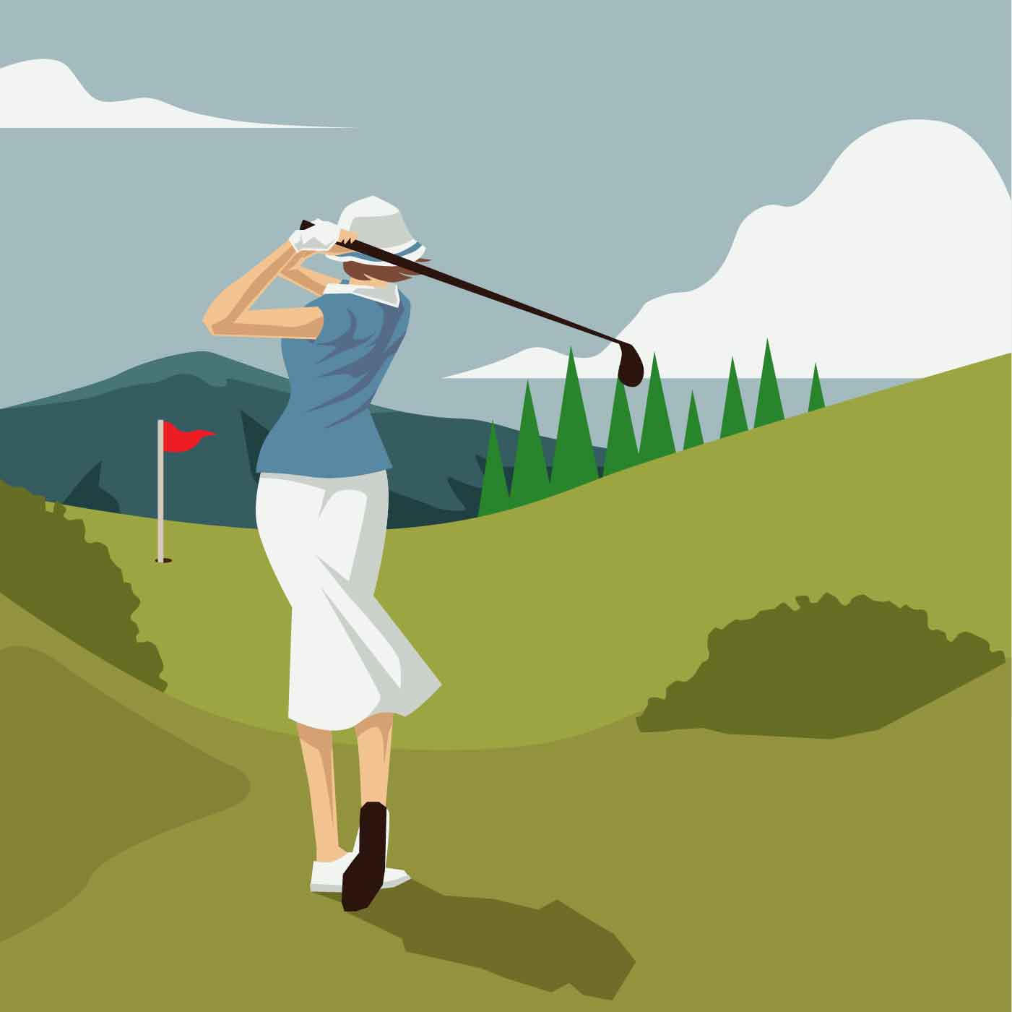
Golf Injury Prevention - Michigan Sports and Spine Center Gladdines, S., von Gerhardt, A.L., Verhagen, E. et al. The effectiveness of a golf injury prevention program (GRIPP intervention) compared to the usual warm-up in Dutch golfers: protocol design of a randomized controlled trial. BMC Sports Sci Med Rehabil 14, 144 (2022). https://doi.org/10.1186/s13102-022-00511-4.
Reference
CAUSES
Poor technique
Overuse
Lack of flexibility

